Slide 1
Scenario Analysis
In Credit Risk
PRESENTED BY Zhiqi Wang, Xingyi Chen,Changlin Yi, Liujia Zhang
Fall 2024
Notes:
Today, we will be discussing Scenario Analysis in Credit Risk.We will discuss how different machine learning models perform best in Scenario Analysis problems, especially when faced with emergencies such as covid-19.Scenario Analysis is a very important analysis method when dealing with credit risk, especially through machine learning model analysis, which can make data analysis more efficient.

Slide 2
What is Scenario Analysis ?
· A strategic planning tool that explores multiple possible future outcomes by evaluating alternative scenarios
· Application in Credit Risk Assessment
· Purpose
Enhance institutional resilience through proactive risk identification
Calculate potential losses and determine capital reserve requirements
Support strategic decision-making during economic uncertainty
Notes:
Scenario analysis is a strategic planning method that helps organizations prepare for an uncertain future. Unlike traditional forecasting that tries to predict a single future outcome, scenario analysis embraces multiple possibilities, allowing organizations to identify potential risks and opportunities across different futures.
When we apply this to credit risk assessment, it becomes a powerful tool for financial institutions to evaluate how adverse economic conditions could impact the probability of default and borrowers' ability to repay loans. For instance, a bank might analyze how their loan portfolio would perform if interest rates suddenly spike, if unemployment rises sharply, or if a particular industry faces a downturn. Financial institutions use this approach to analyze their portfolio vulnerabilities under different market conditions, effectively stress-testing their loan books.
There are three key purposes of scenario analysis: first, it enhances institutional resilience by proactively identifying potential risks before they materialize; second, it helps institutions calculate potential losses and determine appropriate capital reserve requirements; and third, it provides crucial support for strategic decision-making during periods of economic uncertainty.
By understanding and implementing scenario analysis, financial institutions can better protect themselves against adverse conditions while maintaining strong risk management practices - essentially having a financial weather forecast that helps them prepare for different types of economic storms before they hit.

Slide 3
Current approach & Limitations
· Predefined economic scenarios or stress tests
Heavily depend on Historical Trends and Fixed Assumptions
Shaped by the Biases of the designers
· Monte Carlo
Inadequately captures the Non-Linear and Interdependent Pattern
· Agent-Based Models (ABMs) and Generative adversarial networks (GANs)
Computational Intensity
Notes:
· Typically based on historical data and expert-defined parameters
· Extensively used to perform probabilistic scenario analysis by generating a wide range of possible outcomes based on random variation in input parameters.
· Integrated with traditional methods for richer scenario analysis. As a tool to create synthetic financial scenarios. For example, in 2023, Flaig & Junike demonstrated how GAN-based scenario generators can produce diverse hypothetical conditions for market risk modeling.
· While scenario analysis has proven to be a valuable tool for understanding and mitigating financial risks, its effectiveness is often constrained by limitations in those methods.
· As we have demonstrated before, the heavy dependance on historical trends and fixed assumptions may not account for novel or extreme market conditions. Similarly, predefined scenarios are often shaped by bias of designers, which may not sufficiently explore the full spectrum of potential risks.
· Monte Carlo due to its inherent assumptions about independence and linearity.
· the advanced methods, including the examples as we’ve mentioned before, sometimes require significant computational resources, limiting their scalability for smaller instructions.

Slide 4
Machine Learning as a Powerful Solution
· Adapts dynamically to Complex Relationships
Neural Networks and Regression Analysis
E.g. Bitcon price estimation (Cai et al., 2022)
· Improve Non-Linear Modeling
Neural networks and gradient boosting machines
· Address class Imbalance Issue
Random Forest
· Integration of structured and unstructured data
· Unsupervised Machine Learning
Clustering, Anomaly Detections
Notes:
· in combination with what-if analysis and historical data to estimate Bitcoin price volatility under different hypothetical scenarios. This integrated approach enhanced their ability to quantify risk exposure and identify correlations among various shocks, such as policy uncertainty and market sentiment.
· which excel in detecting complex relationships in data, outperforming traditional methods in scenarios with non-linear dependencies can help compensate the limitation of Monte Carlo Simulations.
· a famous ML tool effective in addresses class imbalance issues, a common challenge in credit risk datasets.

Slide 5
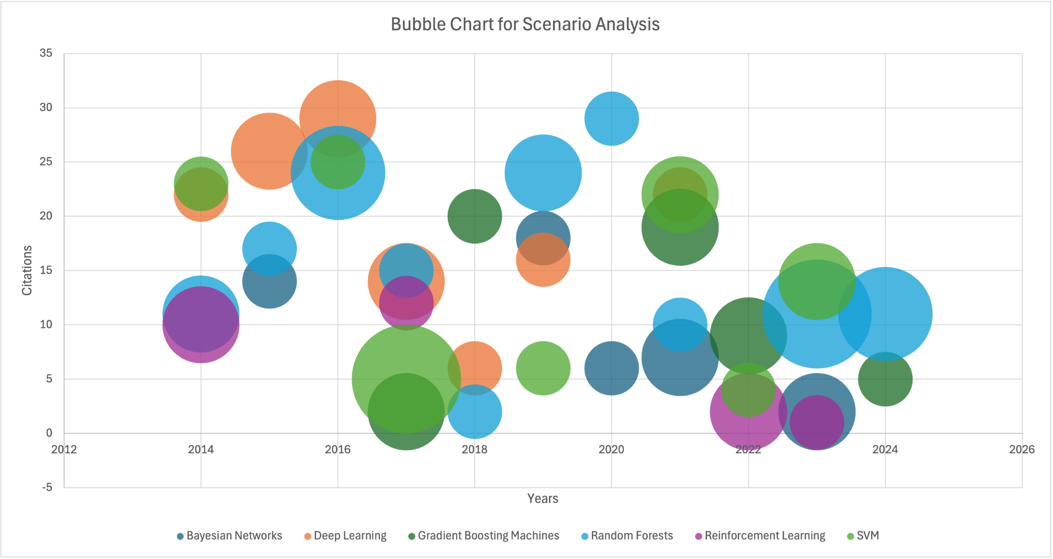
Landscape Scenario Analysis
Date from:https://docs.google.com/document/d/18vZYLrrVZACYK92JIfP2Zjg09-Bpf9jkf2B9MXaoxg4/edit?usp=sharing
Notes:
We searched 77 papers reference on the application of ML models in Scenario Analysis through Google Scholar. Random Forest is the most common application of machine learning model in Scenario Analysis. This is not only reflected in the financial field, but also in the fields of biology and environmental science.You can view the APA reference data of the literature review through the link at the bottom of the PPT

Slide 6
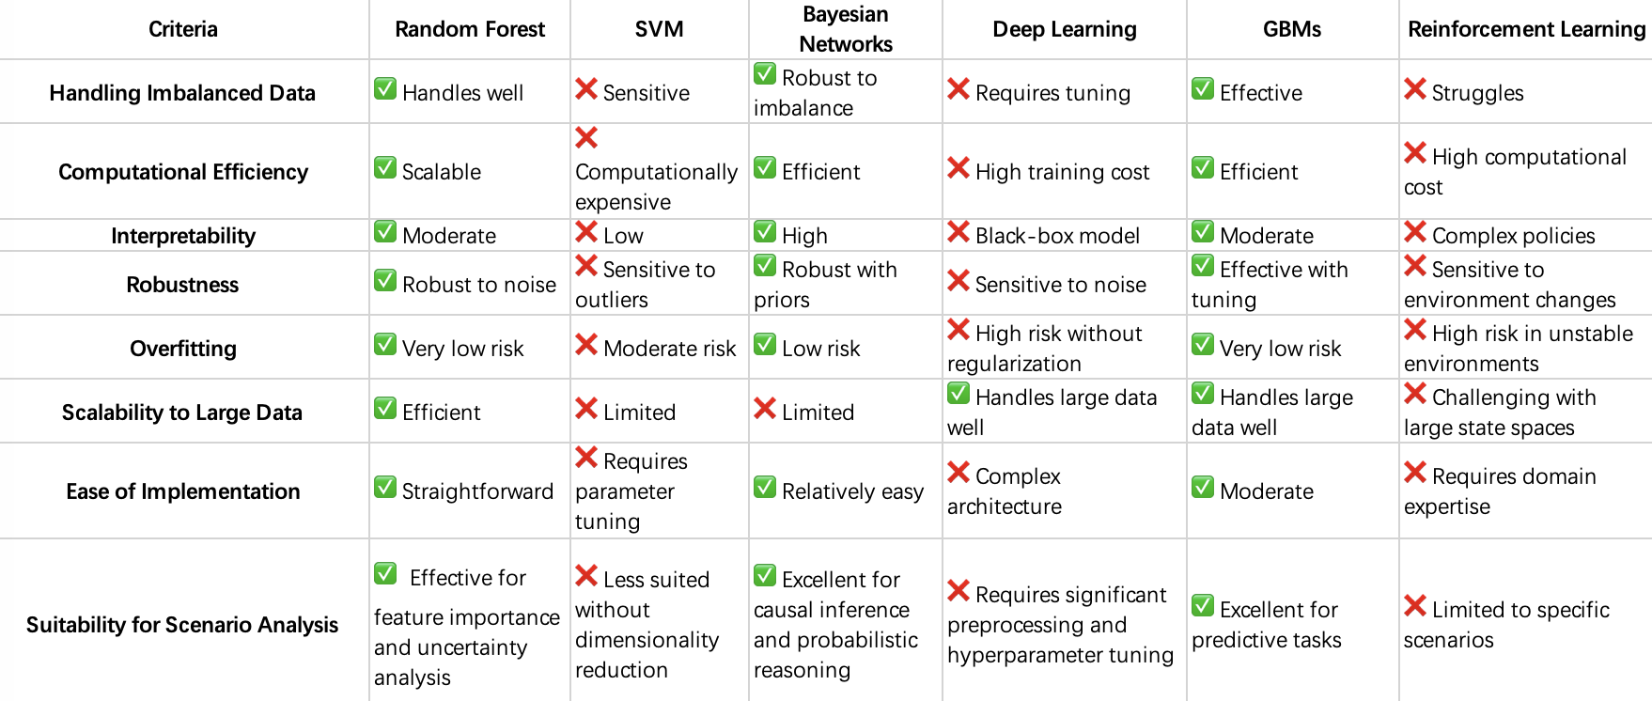
Why choosing Random Forest
Notes:
This table compares various machine learning methods across key criteria, offering insights into their strengths and limitations. Random Forest is versatile, handling imbalanced data, noise, and overfitting well, with scalability and moderate interpretability. SVM, while accurate for specific tasks, struggles with imbalanced data, scalability, and interpretability, often requiring parameter tuning. Bayesian Networks excel in interpretability and robustness due to their probabilistic foundations but are limited in scalability. Deep Learning shines with large datasets and complex tasks but is computationally expensive, prone to overfitting without regularization, and lacks interpretability due to its black-box nature. Gradient Boosting Machines (GBMs) are effective for imbalanced data, predictive tasks, and handling large datasets, but they require parameter tuning to optimize performance. Reinforcement Learning, though powerful in specific scenarios like dynamic decision-making, faces challenges with imbalanced data, scalability, and interpretability. It requires domain expertise and can be computationally expensive.
Overall, the choice of a method depends on the task at hand, data size, and requirements for interpretability and efficiency. Random Forest and GBMs are robust general-purpose models, Although GBMs and RF have many advantages in dealing with scenario analysis problems, Random Forest is faster, simpler, and more robust, making it ideal for quick deployment or noisy data.RF handles noisy data better due to random sampling, while GBMs may overfit noisy points.

Slide 7
Why choosing Random Forest
Key Benefits：
Handles Non-Linearity:Captures complex relationships without extensive feature engineering, outperforming SVM.
Reduces Overfitting:Ensemble approach minimizes overfitting, especially in small datasets.
Efficient:Faster than Deep Learning, suitable for medium-sized datasets.
Great for Scenario Analysis:Robust to noisy data and identifies key features effectively.
Notes:
Handles Non-Linearity: Random Forest captures complex, non-linear relationships without needing much feature engineering, outperforming simpler models like SVM.
Reduces Overfitting: Its ensemble approach lowers the risk of overfitting, especially in small datasets, compared to Deep Learning or SVM.
Works with Missing Data: Random Forest can handle missing data directly without extra steps like imputation.
Easy to Use: It requires little parameter tuning, making it easier compared to complex models like Gradient Boosting or Deep Learning.
Efficient: Random Forest is faster than Deep Learning and works well for medium-sized datasets.
Great for Scenario Analysis: It’s robust to noisy data and identifies important features, making it perfect for scenario planning.

Slide 8
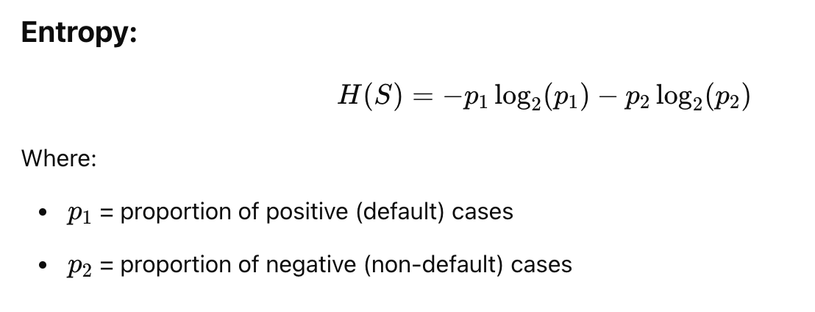
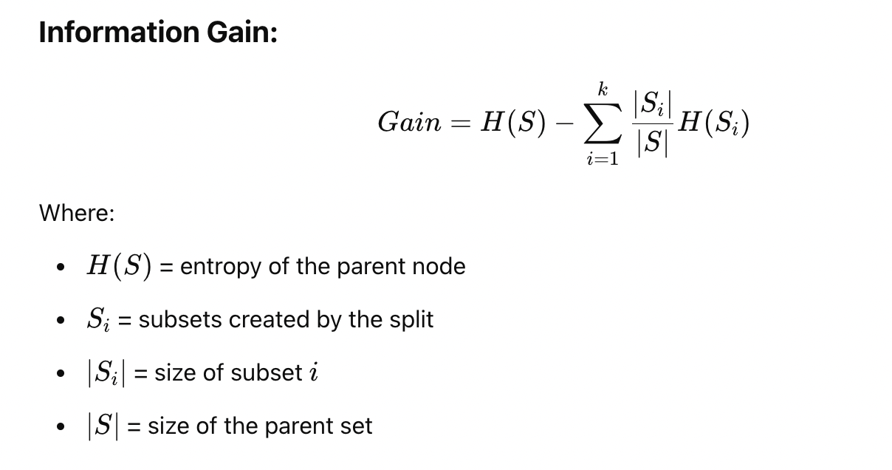
Hands On
Our goal is to predict if default payment or not
2 Scenarios: Normal and COVID Condition
2 Class: 1 for Yes, 0 for No to predict between
3 Predictive Features: Limit balance, Income, Employment status
Notes:
Our primary goal is to predict whether a customer will default on payment or not. The prediction is modeled as a binary classification problem with two classes: 1 for 'Yes' (default) and 0 for 'No' (no default). We analyze two distinct scenarios—Normal and COVID conditions—to account for variations in economic circumstances. The model utilizes three predictive features: Limit Balance, Income, and Employment Status. These features help identify patterns and trends related to default risk under different conditions, enabling targeted risk assessment and decision-making.
Hands-On Methodology: The hands-on work involved building decision trees for both Normal and COVID scenarios to model default probabilities. The process started with data preprocessing, including filtering datasets based on Limit Balance, Employment Status, and Income levels. Each decision tree was constructed step-by-step using a recursive partitioning approach.
Entropy and Information Gain Calculations: Entropy and Information Gain were calculated at each step to determine the most informative splits. Entropy measures the disorder or uncertainty in the data, calculated using the formula: H(S) = -p1log2(p1) - p2log2(p2), where p1 and p2 are the proportions of default and non-default cases. Splitting features, such as LIMIT_BAL, INCOME, or Employment Status, reduce uncertainty by creating groups with more homogeneous outcomes.
Information Gain is used to evaluate the effectiveness of each split. It measures the reduction in entropy achieved after a split and is computed as: Gain = H(S) - Weighted sum of child entropies. The feature with the highest information gain is selected at each node, ensuring that the splits maximize the reduction in uncertainty.
Tree Splits: Each tree was built by evaluating features and selecting splits that provided the highest information gain. For example:
Tree 1 split based on LIMIT_BAL and INCOME.
Tree 2 split based on LIMIT_BAL and Employment_Status.
Tree 3 split based on INCOME and Employment_Status.
The process was repeated for both scenarios—Normal and COVID—using datasets filtered by specific conditions, such as employment type, limit balance level or income level.

Slide 9
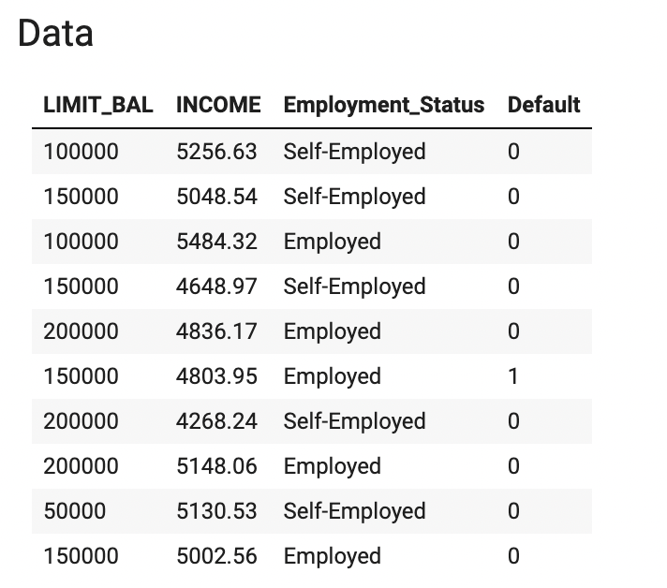
Normal Scenario
Notes:
Here is data used for normal scenario.

Slide 10
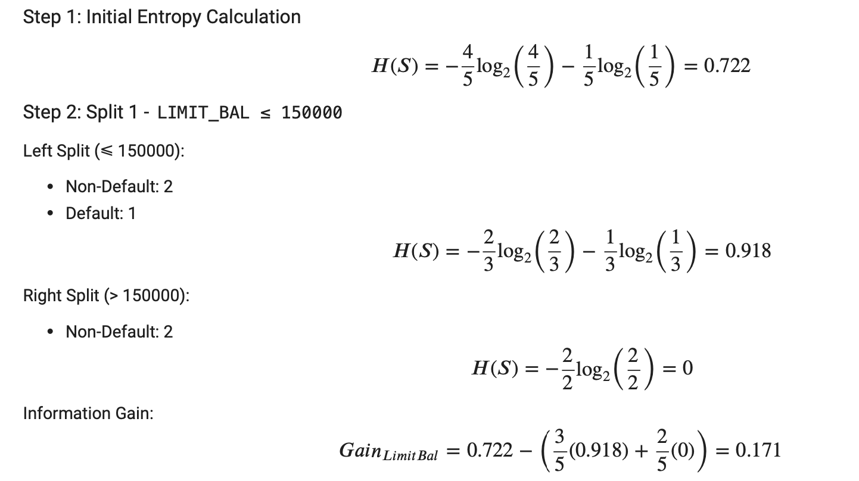
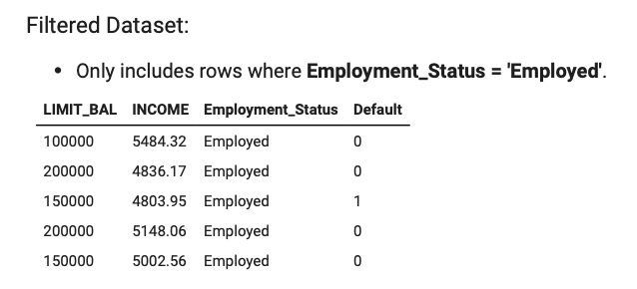
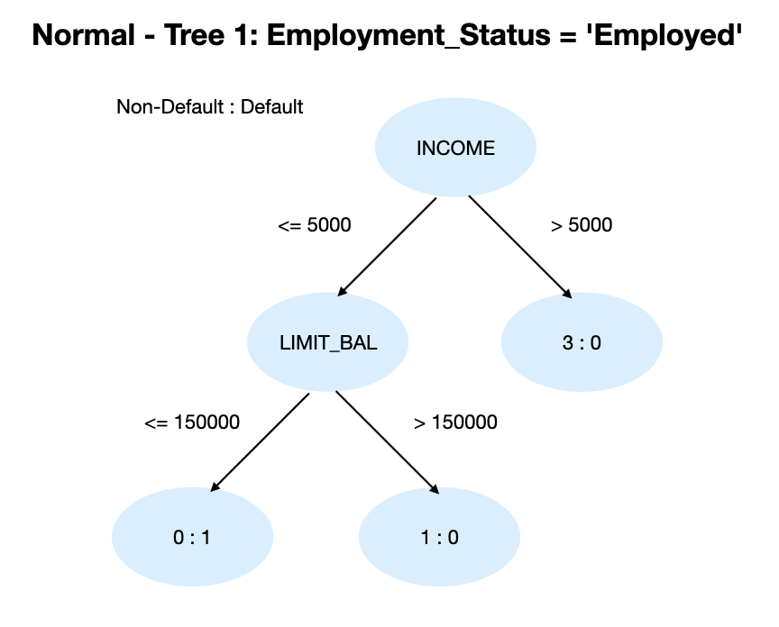
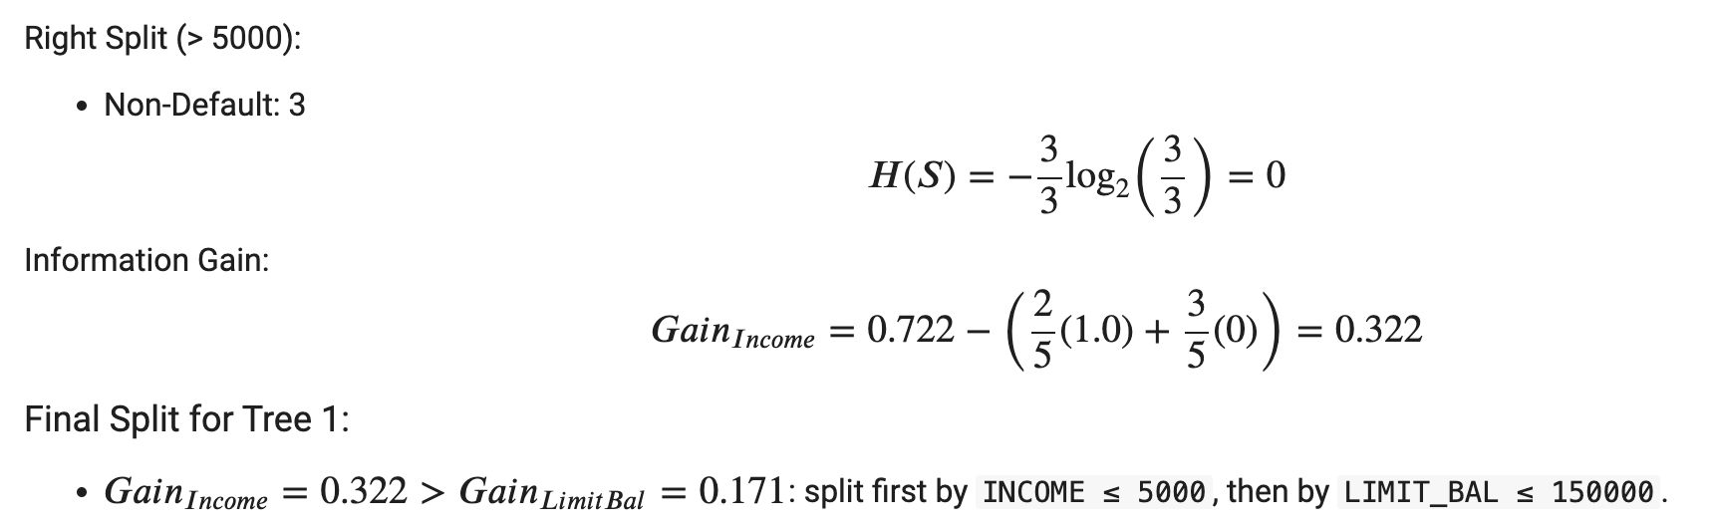
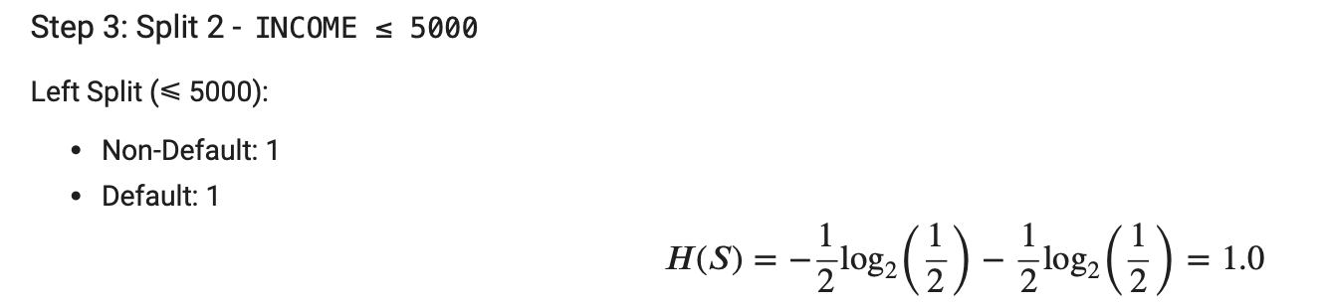
Tree 1 - Splitting Based on LIMIT_BAL and INCOME
Notes:
Normal Condition - Tree 1
Splitting Based on LIMIT_BAL and INCOME
Step 1: Filter Dataset: Employment_Status = 'Employed'
Step 2: Split 1 - LIMIT_BAL ≤ 150000
Left Split (≤ 150000): Non-Default = 2, Default = 1
Right Split (> 150000): Non-Default = 2
Step 3: Split 2 - INCOME ≤ 5000
Left Split (≤ 5000): Non-Default = 1, Default = 1
Right Split (> 5000): Non-Default = 3
Final Split: INCOME ≤ 5000 → LIMIT_BAL ≤ 150000
Speaker Notes: This tree begins by filtering only employed individuals and splits based on the LIMIT_BAL threshold of 150,000 (LIMIT_BAL ≤ 150000). The first split groups customers into those with lower and higher balances. We can calculate the gain from Limit balance using the number of Default and Non-Default. Then split by INCOME. Individuals earning less than 5000 show a higher likelihood of default, with 1 default and 1 non-default. Those earning more than 5000 are safer with no defaults. Since the feature INCOME has a higher gain, it has a higher layer.
Calculation Details: Entropy and Information Gain are calculated at each step. Initial entropy evaluates the proportion of defaults and non-defaults. Splitting by LIMIT_BAL and INCOME reduces uncertainty, measured using the entropy formula: H(S) = -p1log2(p1) - p2log2(p2). The information gain is computed as: Gain = H(S) - weighted sum of child entropies.

Slide 11
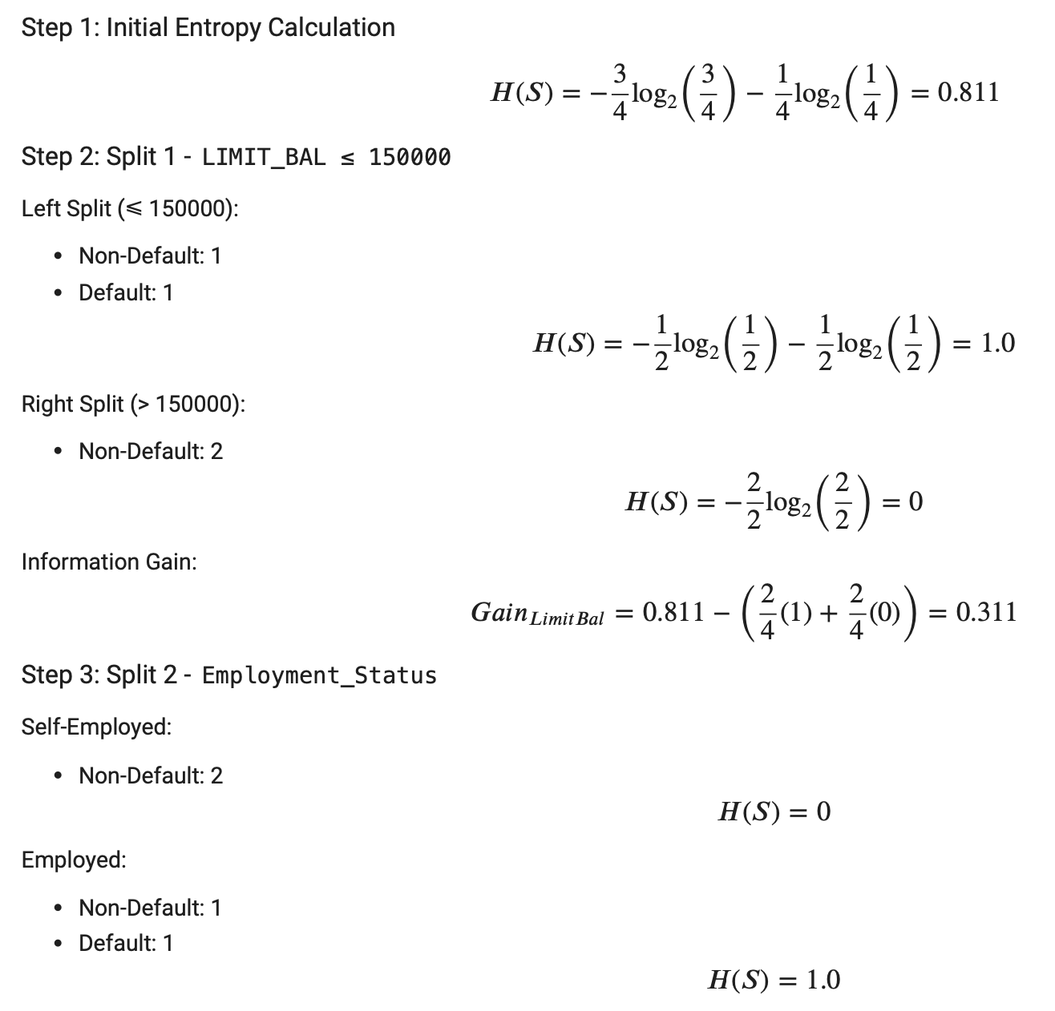
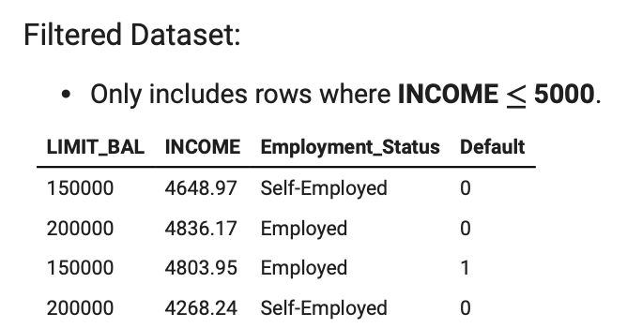
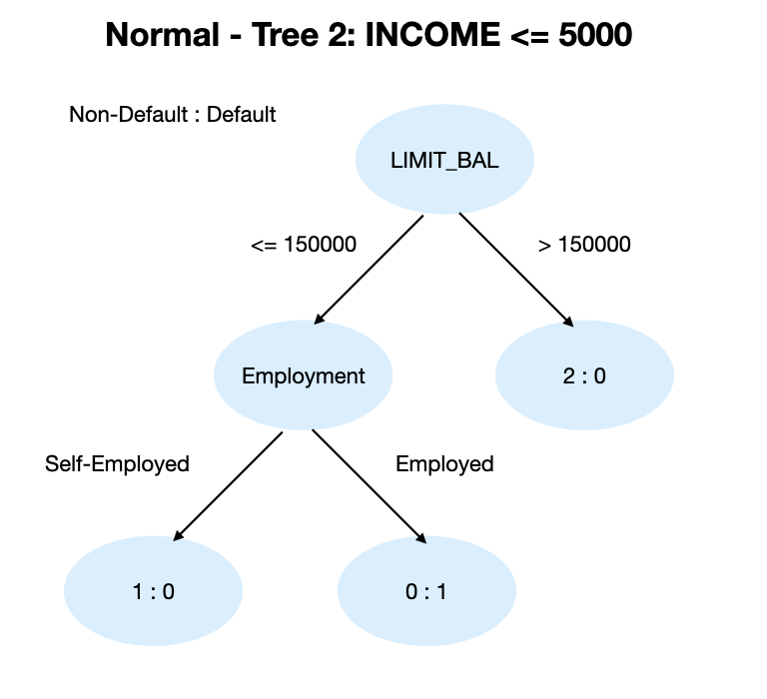
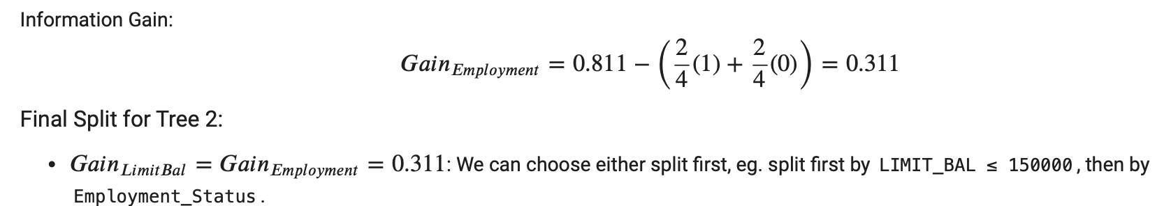
Tree 2 - Based on LIMIT_BAL and Employment_Status
Notes:
Normal Condition - Tree 2
Splitting Based on LIMIT_BAL and Employment_Status
Step 1: Filter Dataset: INCOME ≤ 5000
Step 2: Split 1 - LIMIT_BAL ≤ 150000
Left Split (≤ 150000): Non-Default = 1, Default = 1
Right Split (> 150000): Non-Default = 2
Step 3: Split 2 - Employment_Status
Self-Employed: Non-Default = 2
Employed: Non-Default = 1, Default = 1
Final Split: LIMIT_BAL ≤ 150000 → Employment_Status
Speaker Notes: In this tree, individuals with income ≤ 5000 are analyzed first by their balance limit. We can calculate the gain from Limit balance using the number of Default and Non-Default. Then split by employment status, and calculate the gain from employment status using the number of Default and Non-Default. Since the gain from employment status and Limit balance are equal, we can choose either as the higher layer.
Calculation Details: Entropy and information gain are recalculated at each split. Employment_Status is chosen due to higher information gain compared to other features, reducing uncertainty significantly at each step.

Slide 12
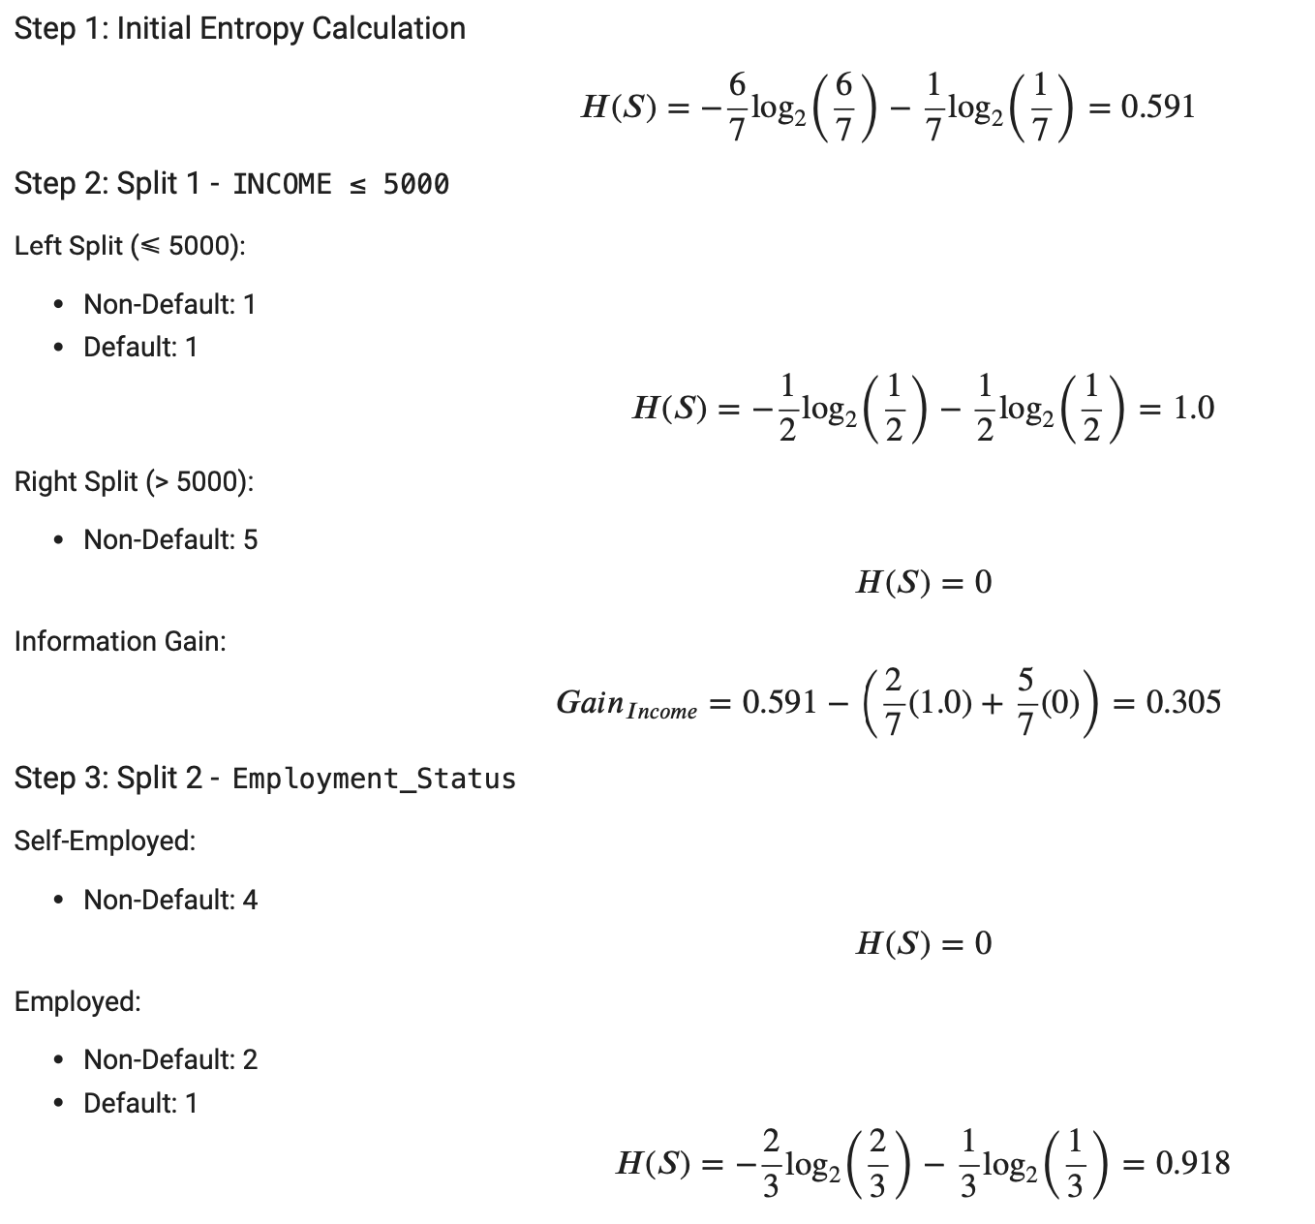
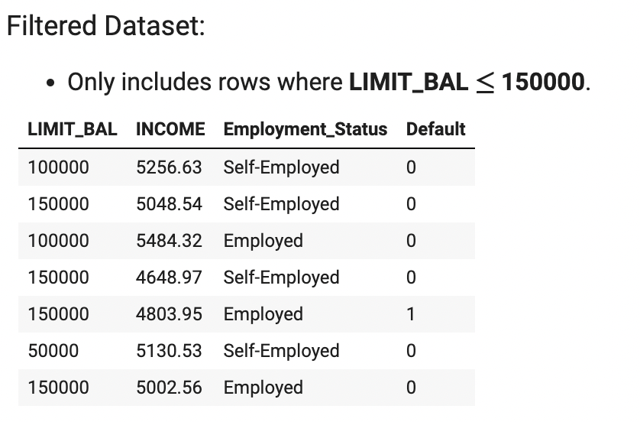
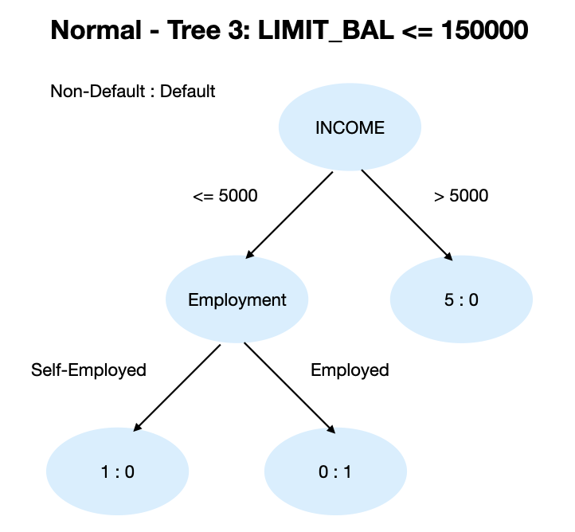
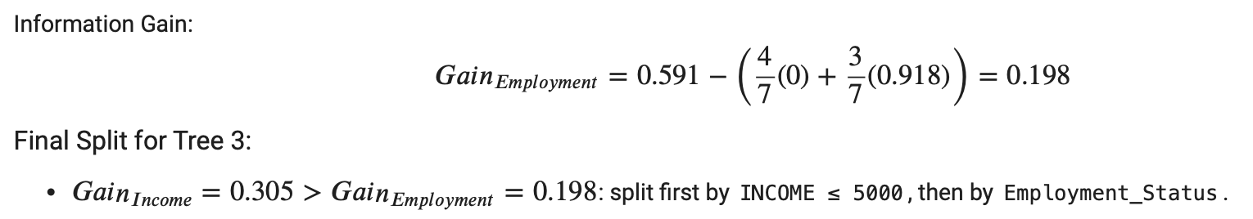
Tree 3 - Based on INCOME and Employment_Status
Notes:
Normal Condition - Tree 3
Splitting Based on INCOME and Employment_Status
Step 1: Filter Dataset: LIMIT_BAL ≤ 150000
Step 2: Split 1 - INCOME ≤ 5000
Left Split (≤ 5000): Non-Default = 1, Default = 1
Right Split (> 5000): Non-Default = 5
Step 3: Split 2 - Employment_Status
Self-Employed: Non-Default = 4
Employed: Non-Default = 2, Default = 1
Final Split: INCOME ≤ 5000 → Employment_Status
Speaker Notes: This tree examines individuals with balances below 150,000. Income is the first splitting criterion, with low-income individuals (≤ 5000) showing a higher chance of default. We can calculate the gain from Income using the number of Default and Non-Default. Further splits by employment. Then calculate the gain from employment status using the number of Default and Non-Default. Since the feature INCOME has a higher gain than Employment status, it has a higher layer.

Slide 13
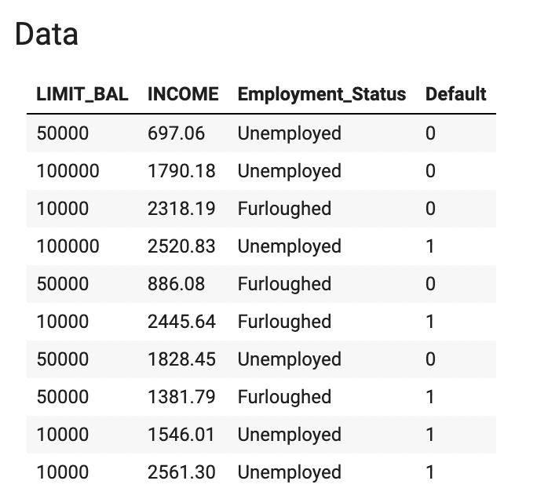
COVID Scenario
Notes:
Here is data used for COVID scenario.

Slide 14
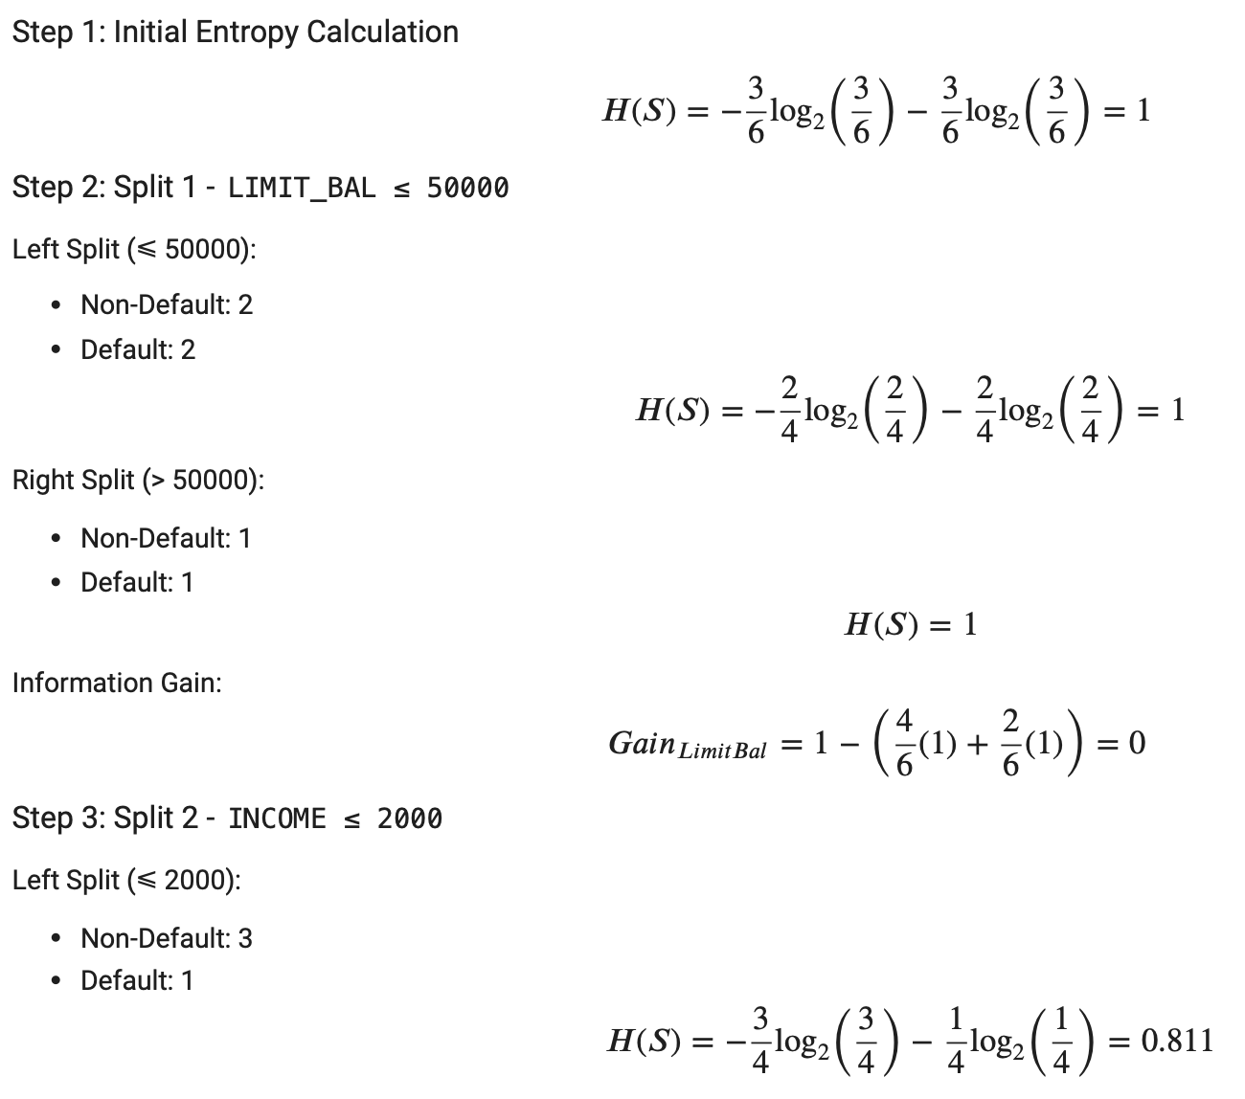
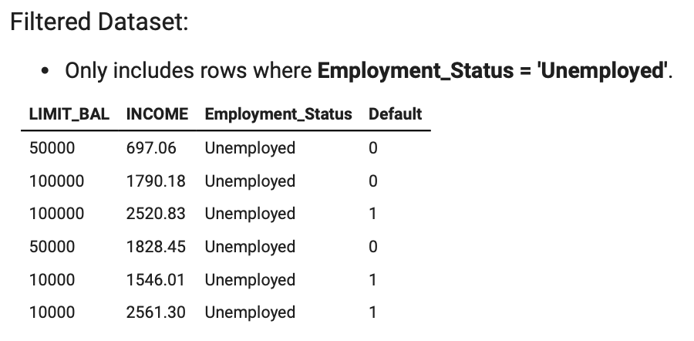
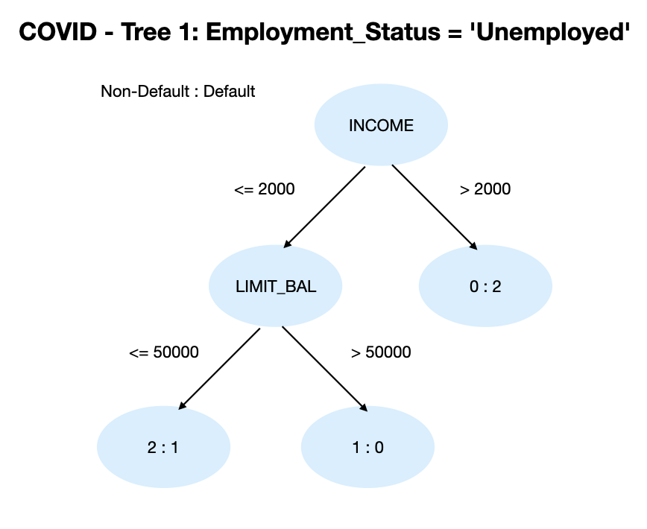
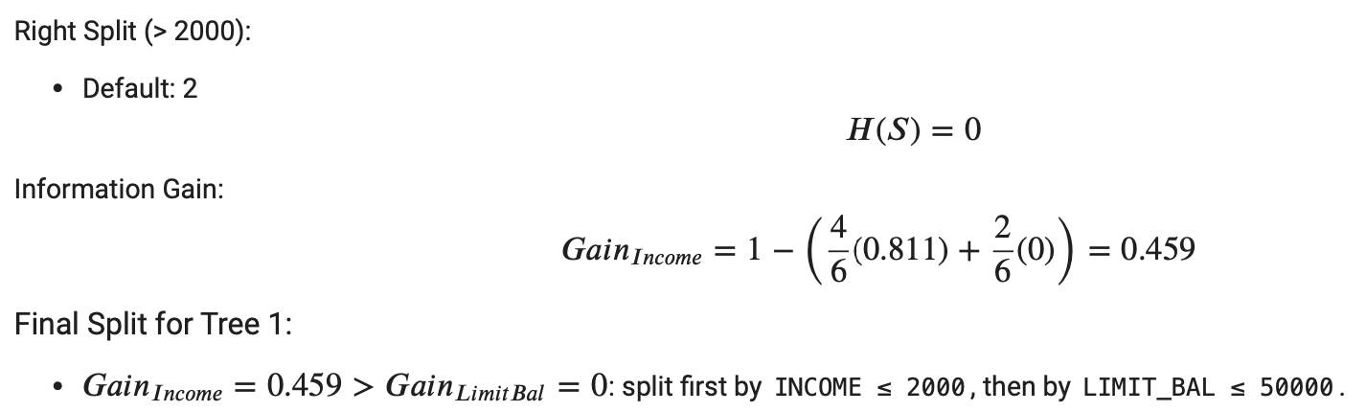
Tree 1 - Splitting Based on LIMIT_BAL and INCOME
Notes:
COVID Condition - Tree 1
Splitting Based on LIMIT_BAL and INCOME
Step 1: Filter Dataset: Employment_Status = 'Unemployed'
Step 2: Split 1 - LIMIT_BAL ≤ 50000
Left Split (≤ 50000): Non-Default = 2, Default = 2
Right Split (> 50000): Non-Default = 1, Default = 1
Step 3: Split 2 - INCOME ≤ 2000
Left Split (≤ 2000): Non-Default = 3, Default = 1
Right Split (> 2000): Default = 2
Final Split: INCOME ≤ 2000 → LIMIT_BAL ≤ 50000
Speaker Notes: Under COVID conditions, unemployed individuals are analyzed. Follow the same process for previous trees, calculate the gain from LIMIT_BAL and INCOME. Since the feature INCOME has a higher gain than Limit Balance, it has a higher layer.
Calculation Details: Entropy measures disorder within unemployed groups. Information gain calculations prioritize splits that reduce uncertainty, emphasizing low-balance and low-income as high-risk indicators.

Slide 15
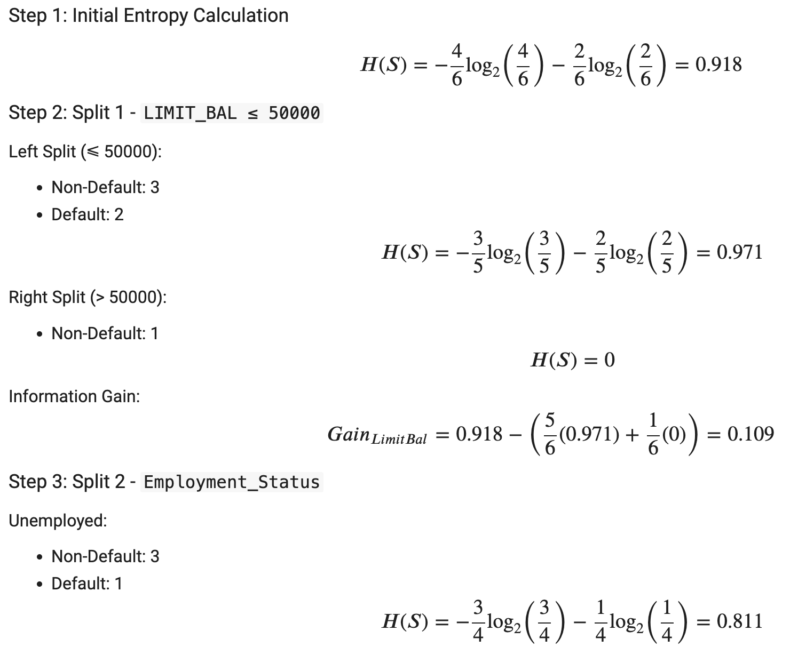
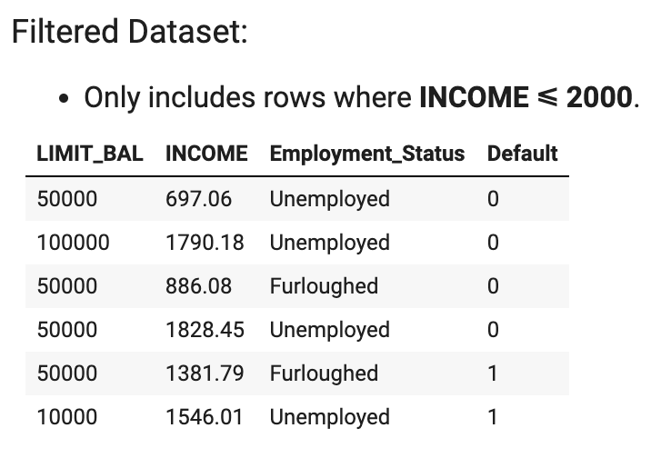
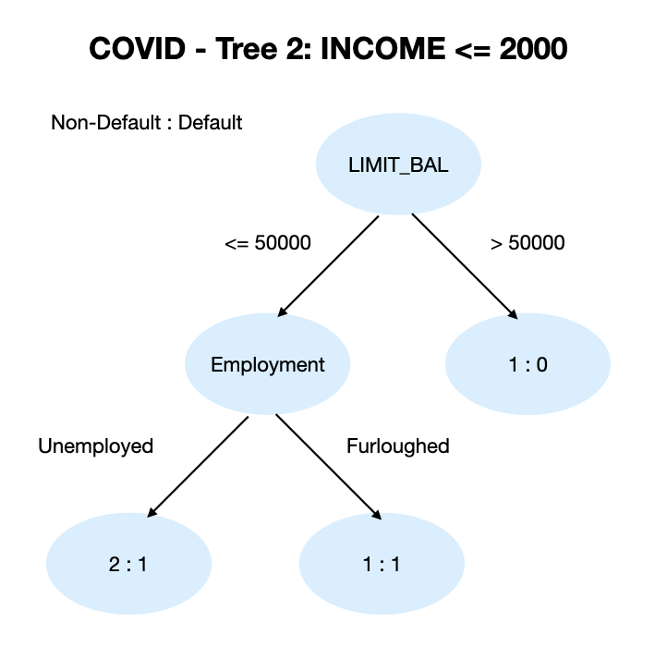
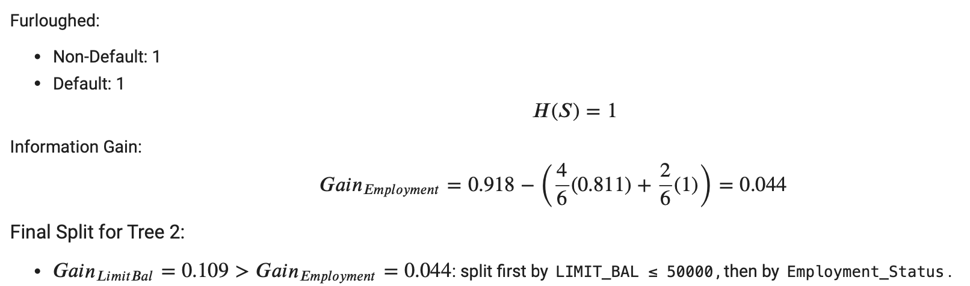
Tree 2 - Based on LIMIT_BAL and Employment_Status
Notes:
COVID Condition - Tree 2
Splitting Based on LIMIT_BAL and Employment_Status
Step 1: Filter Dataset: INCOME ≤ 2000
Step 2: Split 1 - LIMIT_BAL ≤ 50000
Left Split (≤ 50000): Non-Default = 3, Default = 2
Right Split (> 50000): Non-Default = 1
Step 3: Split 2 - Employment_Status
Unemployed: Non-Default = 3, Default = 1
Furloughed: Non-Default = 1, Default = 1
Final Split: LIMIT_BAL ≤ 50000 → Employment_Status
Speaker Notes: This tree looks at individuals earning less than 2000. Follow the same process for previous trees, calculate the gain from LIMIT_BAL and Employment status. Since the feature LIMIT_BAL has a higher gain than Employment status, it has a higher layer.

Slide 16
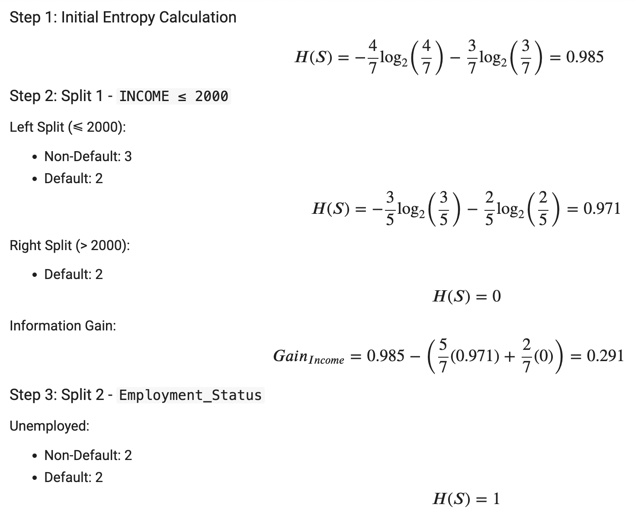
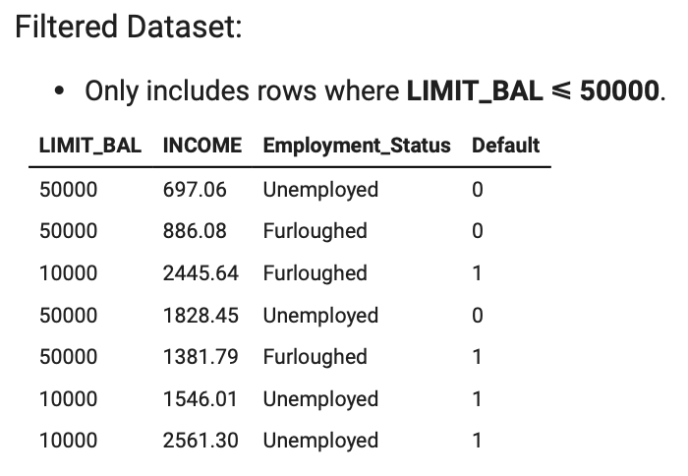
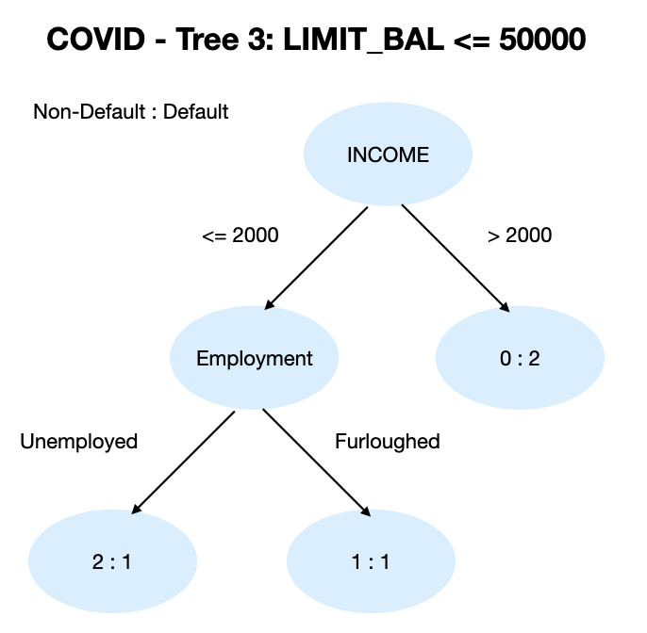
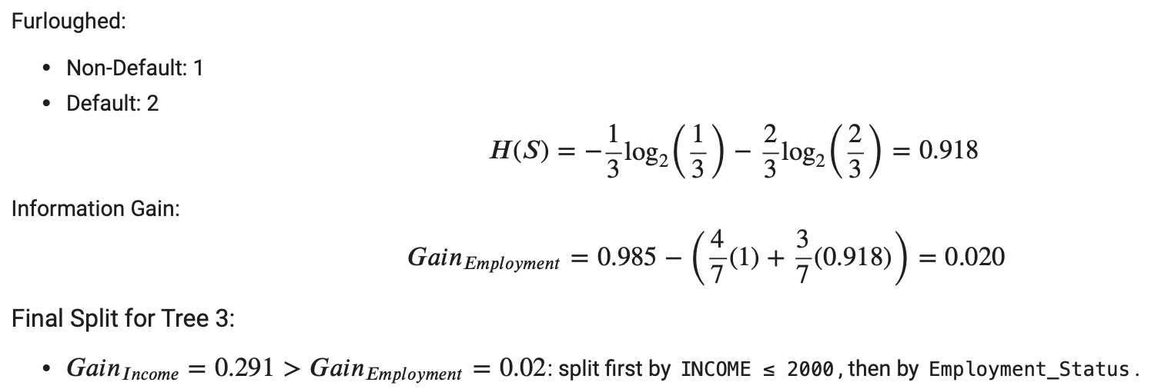
Tree 3 - Based on INCOME and Employment_Status
Notes:
COVID Condition - Tree 3
Splitting Based on INCOME and Employment_Status
Step 1: Filter Dataset: LIMIT_BAL ≤ 50000
Step 2: Split 1 - INCOME ≤ 2000
Left Split (≤ 2000): Non-Default = 3, Default = 2
Right Split (> 2000): Default = 2
Step 3: Split 2 - Employment_Status
Unemployed: Non-Default = 2, Default = 2
Furloughed: Non-Default = 1, Default = 2
Final Split: INCOME ≤ 2000 → Employment_Status
Speaker Notes: This tree starts with individuals having low balances. Follow the same process for previous trees, calculate the gain from INCOME and Employment status. Since the feature INCOME has a higher gain than Employment status, it has a higher layer.

Slide 17
Final Model Prediction
For each scenario:
Combine predictions from all 3 trees using majority voting.
Notes:
For each scenario, predictions from all three trees are combined using a majority voting approach. Each tree provides a classification result, and the final prediction is determined by selecting the most frequent class (either 0 or 1) across the trees. This ensemble method helps improve accuracy by leveraging the strengths of individual decision trees and reducing the risk of overfitting to specific patterns in the data.

Slide 18
Discussion & Future Extension
Scenario: Normal
Observations:
The model performs very well for predicting Non-Defaults (Class 0), achieving high precision, recall, and F1-score.
The imbalance in class distribution (28 vs 2) likely caused the model to focus heavily on the majority class, ignoring the minority class entirely.
High accuracy (93.33%) is misleading since it reflects success in predicting the majority class but fails for the minority class.
Notes:
In the Normal scenario, the model achieves high accuracy (93.33%) and performs exceptionally well for predicting non-default cases. However, it completely fails to predict defaults due to the highly imbalanced dataset, where the majority class dominates. This imbalance leads the model to favor the majority class, resulting in 0.00 precision and recall for defaults. The high accuracy is therefore misleading, highlighting the need for techniques such as oversampling, undersampling, or advanced modeling approaches to better capture patterns for the minority class.

Slide 19
Discussion & Future Extension
Scenario: COVID
Observations:
The model performs poorly overall, with 53.33% accuracy.
Similar to the Normal scenario, it predicts Non-Defaults (Class 0) reasonably well.
The performance drop in this scenario suggests that economic instability during COVID likely introduced higher variability and made predictions more challenging.
The class imbalance (16 vs 14) is less severe compared to the Normal scenario, yet the model struggles with defaults due to lack of robust handling for class imbalance.
Notes:
The COVID scenario reveals a significant drop in performance, with accuracy falling to 53.33%. The model continues to predict non-defaults reasonably well but completely fails to detect defaults. The near-balanced class distribution (16 vs 14) does not resolve the issue, as the model struggles with variability introduced by economic instability. This highlights the need for more robust methods, such as ensemble techniques, advanced classifiers like XGBoost, and stress-testing models to handle sudden economic shifts effectively.

Slide 20
Discussion & Future Extension
How to Improve?
Include more features
Perform stress tests
Feature Engineering
Use advanced models (eg. XGBoost)
Notes:
The current model focuses only on three variables—Limit Balance, Income, and Employment Status. To improve predictive accuracy and gain a deeper understanding of the factors influencing default probability, we should incorporate additional features. Real-world credit risk scenario analysis typically includes variables such as credit history, payment behavior, and macroeconomic indicators. Incorporating these features can provide a more comprehensive analysis.
Performing additional stress tests by simulating extreme economic scenarios can help assess how default probabilities change under adverse conditions. These tests can model the impact of sudden income loss, high inflation, or interest rate hikes, offering insights into potential vulnerabilities in different economic climates.
To further enhance the model, feature engineering techniques should be applied to derive new predictors, such as the debt-to-income ratio, credit utilization rate, and loan-to-value ratios. These engineered features may capture additional nuances that influence default risk.
Advanced machine learning models, such as XGBoost, should also be explored. XGBoost is well-suited for handling class imbalance, a common issue in default prediction datasets, and can achieve higher accuracy through its gradient boosting framework. Combining these approaches with robust evaluation metrics can lead to more accurate and actionable credit risk assessments.

Slide 21
Conclusion
Notes:
Scenario analysis has proven to be an indispensable tool for credit risk assessment and strategic financial planning, offering institutions a structured way to navigate uncertainties and mitigate potential threats. As explored in this paper, traditional approaches like Monte Carlo simulations and stress testing have laid the foundation for risk analysis but face limitations in handling complex, non-linear dependencies and unexpected market shifts.
The integration of machine learning (ML) techniques, such as Random Forest, neural networks, and gradient boosting, represents a significant advancement in overcoming these challenges. By leveraging vast datasets and detecting intricate patterns, ML algorithms enhance the predictive accuracy and scalability of scenario analysis, addressing key issues like class imbalance and computational inefficiency. The application of Random Forest, in particular, offers a balance of interpretability, robustness, and efficiency, making it an ideal choice for scenario analysis in dynamic financial environments.
However, the study highlights the need for continuous improvement. Incorporating additional features, such as payment behavior, economic indicators, and demographic fairness assessments, will enrich the analysis and provide a more comprehensive view of credit risk. Future advancements could focus on developing dynamic models that evolve with real-time data, ensuring financial institutions stay resilient against emerging risks.
Ultimately, the synergy between traditional scenario analysis frameworks and cutting-edge AI/ML solutions positions financial institutions to navigate uncertainty with greater confidence, safeguarding stability and driving informed decision-making in an increasingly volatile economic landscape.

Slide 22
Thank you

